Slide 1
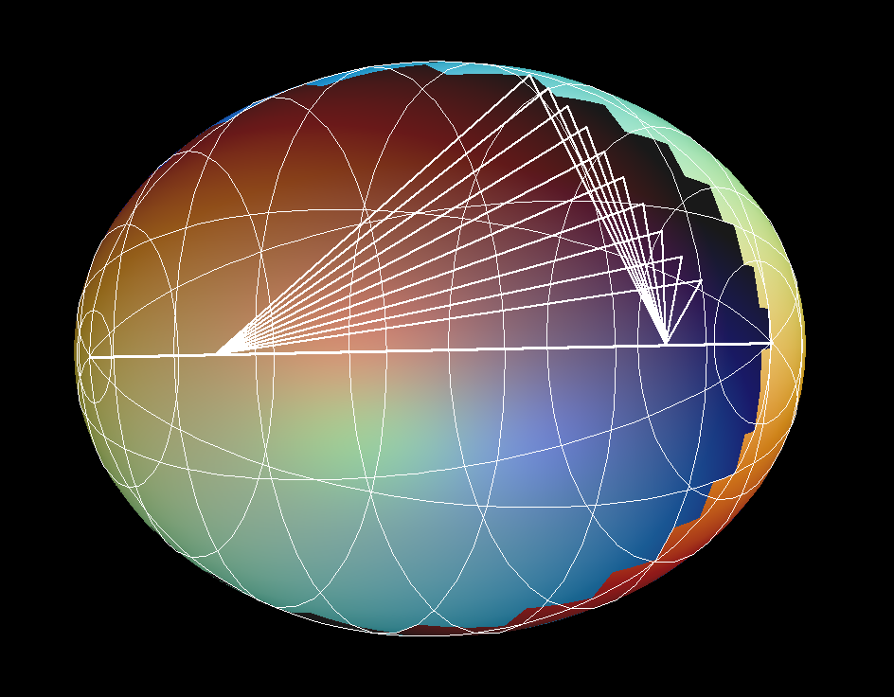
Solving John Ellipsoid by FISTA
Department:EE114
Name:林奐至
Student ID:E24104252

Slide 2
OUTLINE
FISTA and John Ellipsoid
Experiment
Reference

Slide 3
FISTA and John Ellipsoid

Slide 4
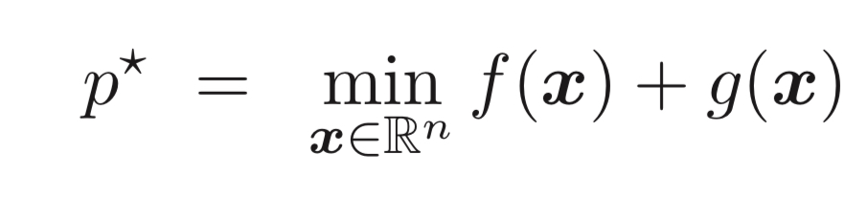
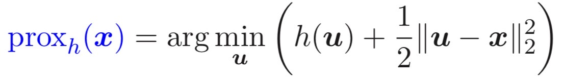
FISTA and John Ellipsoid
Differentiable or non-differential
FISTA
Can solve this problem :
Proximal function :
Differentiable

Slide 5
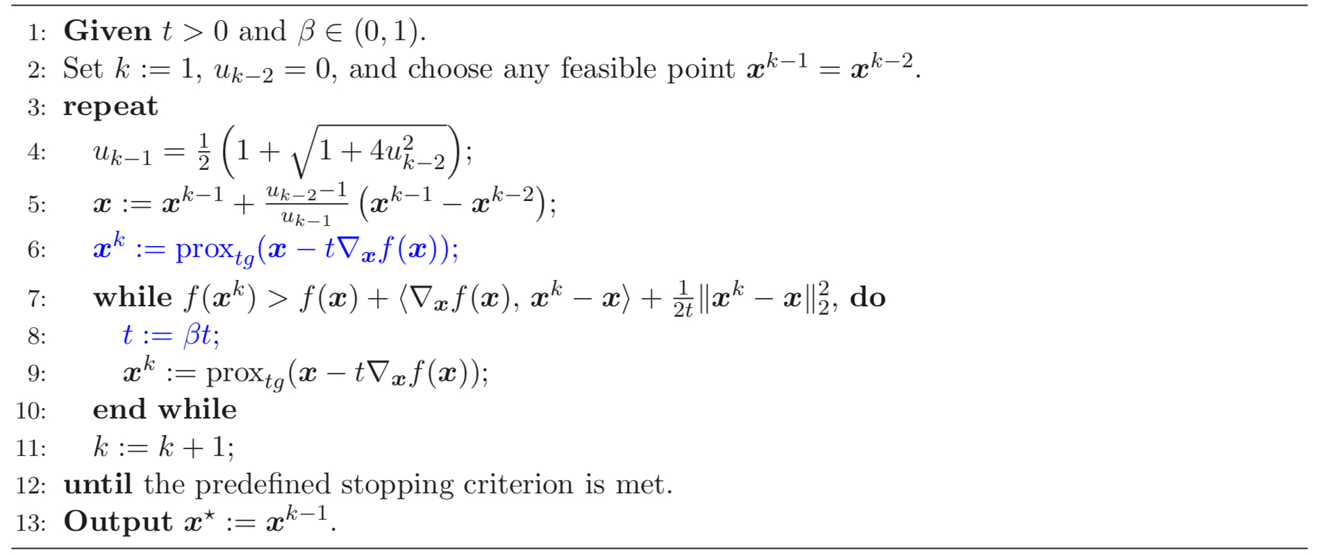
FISTA and John Ellipsoid
Algorithm

Slide 6
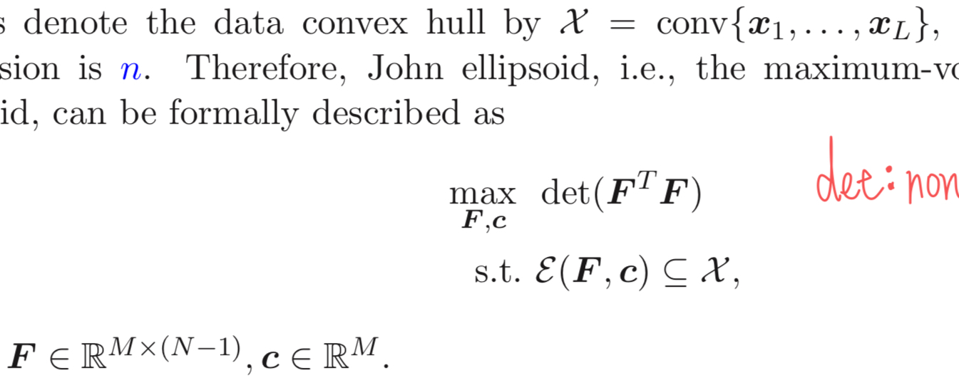
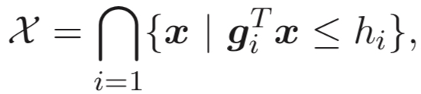
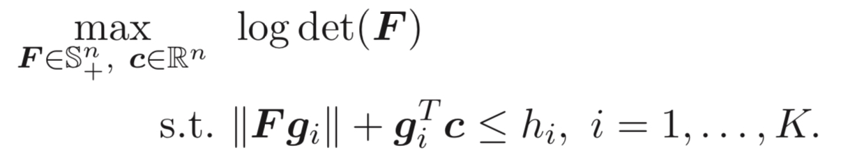
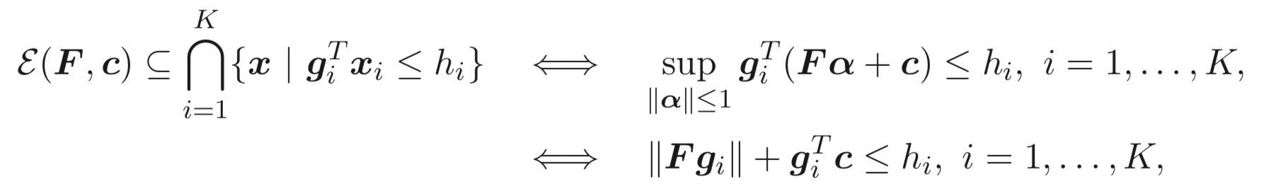

FISTA and John Ellipsoid
John Ellipsoid problem:
Assumed $F∈S_{+}^{n}$

Slide 7
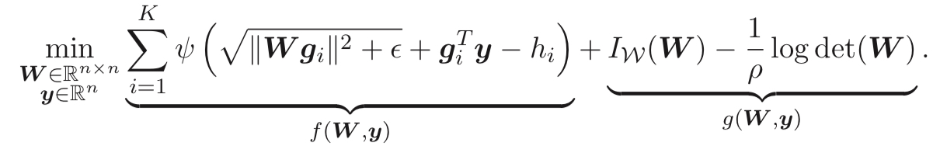
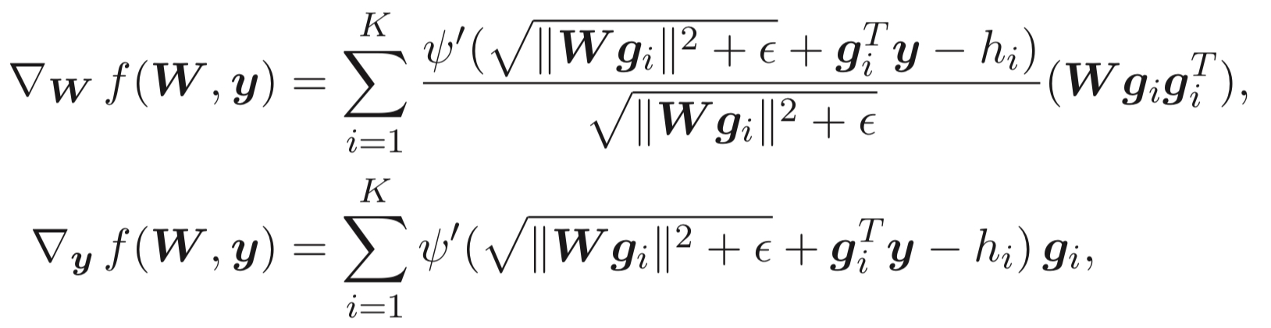
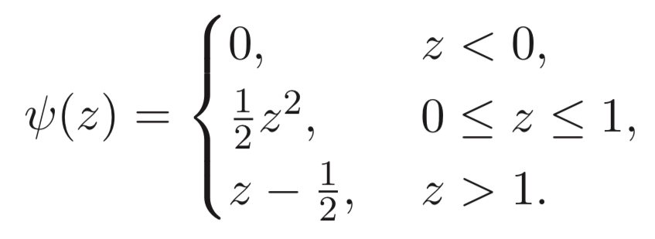
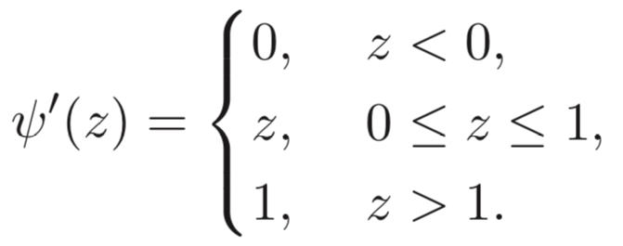
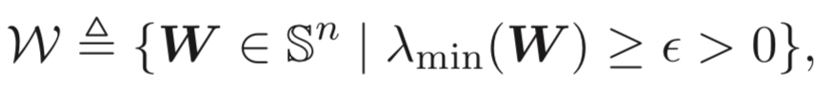
FISTA and John Ellipsoid
Reformulate into the FISTA form:
constrained part
unconstrained part
(Indicator function)

Slide 8
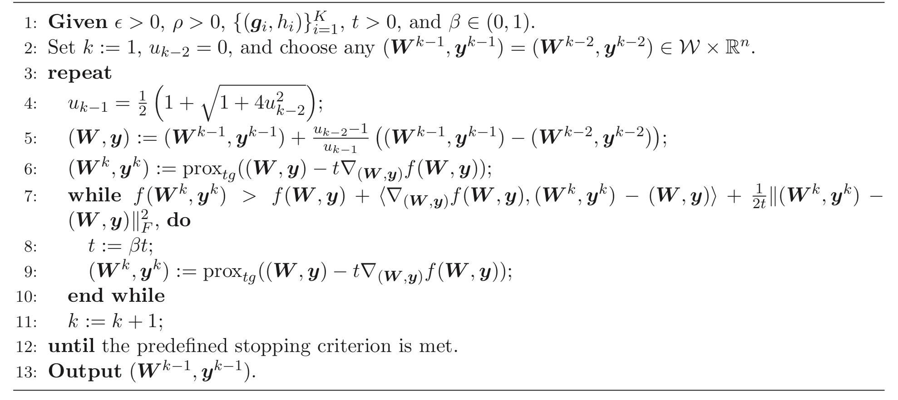
FISTA and John Ellipsoid
Algorithm

Slide 9
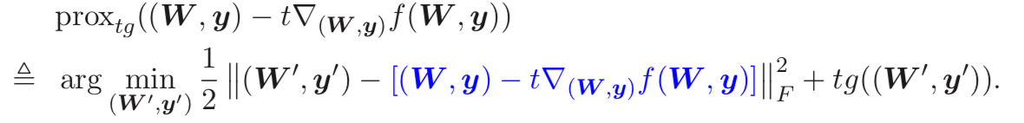
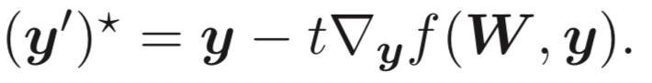
FISTA and John Ellipsoid

Slide 10
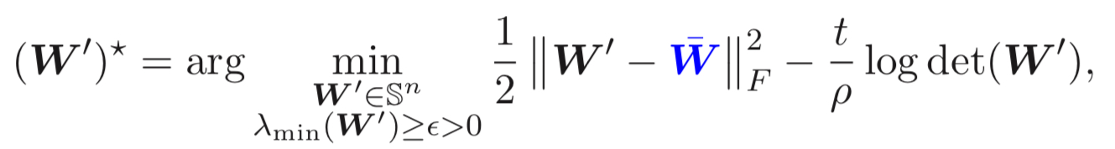
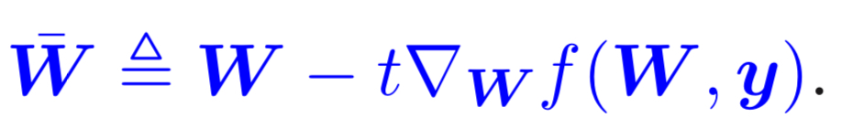
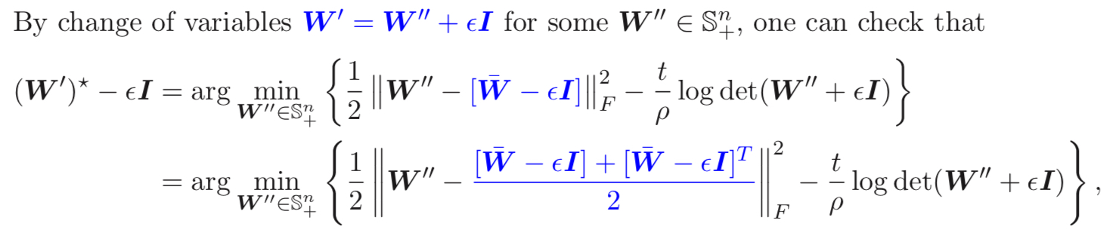
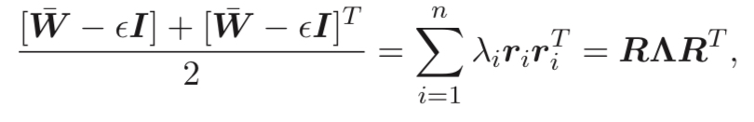
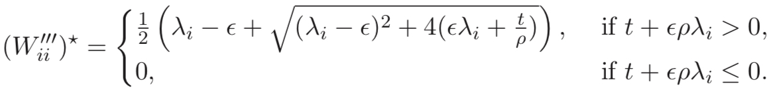
FISTA and John Ellipsoid

Slide 11
Experiment
(MATLAB)

Slide 12
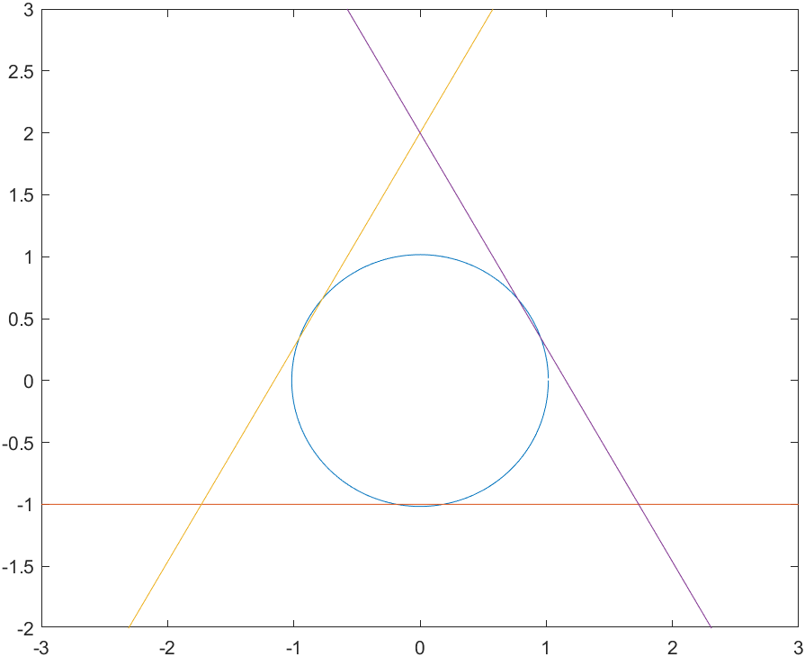


Experiment
Given
Tune the parameters $ε={10}^{−16},ρ=40,β=0.401,t=19$
Initialize $u_{k−2}=0,W^{k−1}=W^{k−2}=I,y^{k−1}=\left[\begin{matrix}1 \\ 0\end{matrix}\right]$ $,y^{k−2}=\left[\begin{matrix}0 \\ 1\end{matrix}\right]$
Stopping criterion : ${\left\|\left(W^{k},y^{k}\right)−\left(W^{k−1},y^{k−1}\right)\right\|}_{F}^{}<0.0001$
Outcome (3772 iterations)
$$W^{k}=\left[\begin{matrix}1.0164 & 0 \\ 0 & 1. 0164\end{matrix}\right]$$
$$y_{k}=\left[\begin{matrix}0 \\ 0.000040753\end{matrix}\right]$$

Slide 13
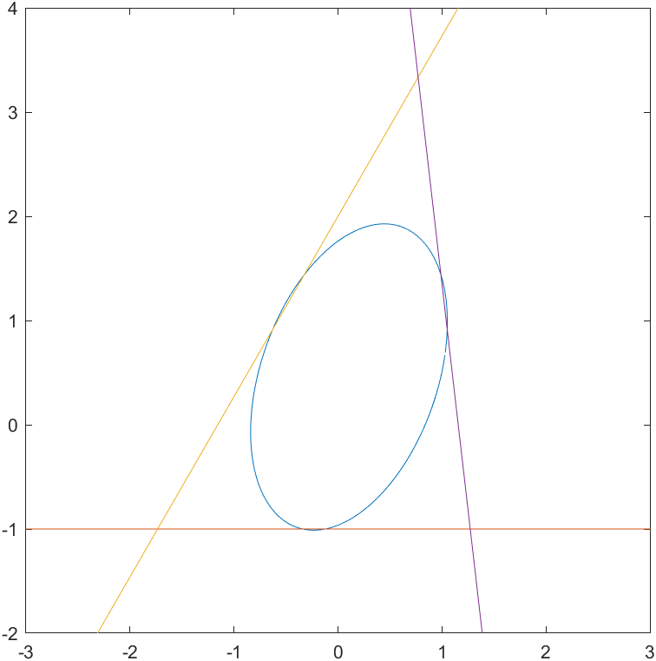


Experiment
Given ${\left\{\left(g_{i},h_{i}\right)\right\}}_{i=1}^{3}=$ $\left\{\left(\left[\begin{matrix}0 \\ −1\end{matrix}\right],1\right),\left(\left[\begin{matrix}−0.5\sqrt{3} \\ 0.5\end{matrix}\right],1\right),\left(\left[\begin{matrix}0.5\sqrt{3} \\ 0.1\end{matrix}\right],1\right)\right\}$
Outcome (2525 iterations)
$$W^{k}=\left[\begin{matrix}0.9210 & 0.2099 \\ 0.2099 & 1.4541\end{matrix}\right]$$
$$y_{k}=\left[\begin{matrix}0.1057 \\ 0.4579\end{matrix}\right]$$

Slide 14
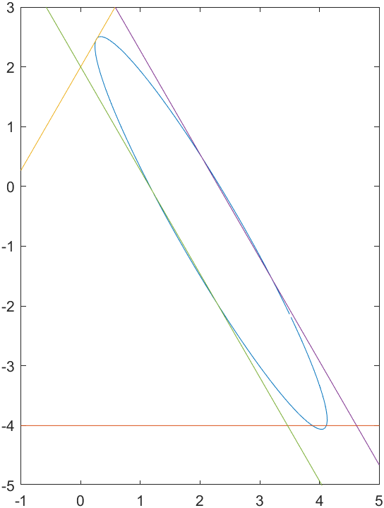


Experiment
Given ${\left\{\left(g_{i},h_{i}\right)\right\}}_{i=1}^{4}=$ $\left\{\left(\left[\begin{matrix}0 \\ −0.25\end{matrix}\right],1\right),\left(\left[\begin{matrix}−0.5\sqrt{3} \\ 0.5\end{matrix}\right],1\right),\left(\left[\begin{matrix}0.5\sqrt{3} \\ 0.5\end{matrix}\right],2\right),\left(\left[\begin{matrix}−0.5\sqrt{3} \\ −0.5\end{matrix}\right],−1\right)\right\}$
Outcome (2638 iterations)
$$W^{k}=\left[\begin{matrix}1.3376 & −1.4097 \\ −1.4097 & 2.9655\end{matrix}\right]$$
$$y_{k}=\left[\begin{matrix}2.1833 \\ −0.7778\end{matrix}\right]$$

Slide 15
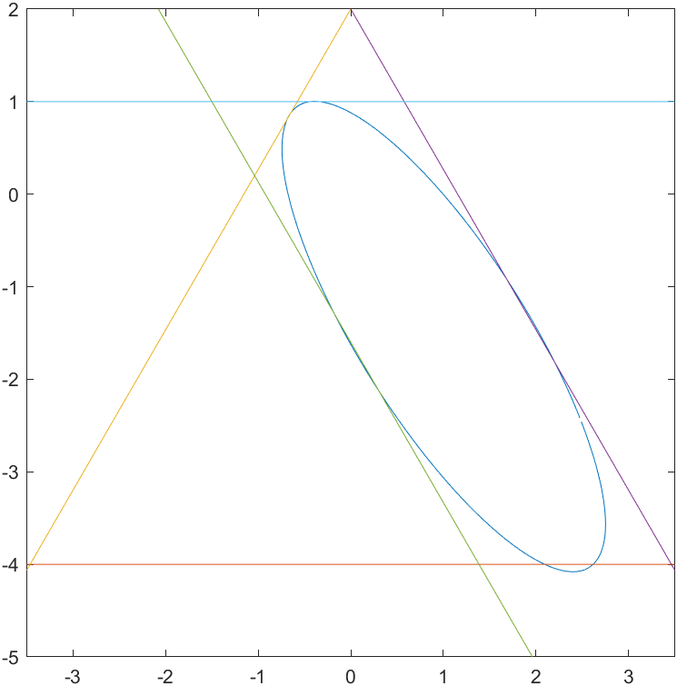
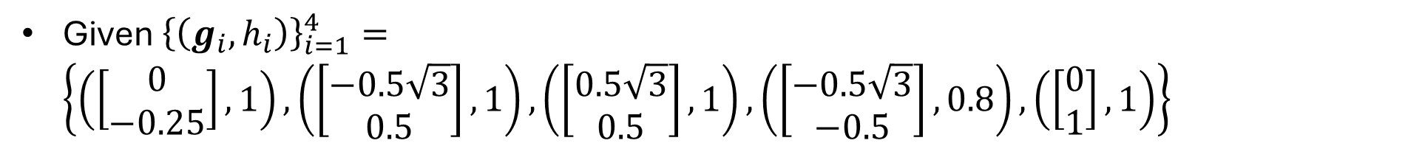


Experiment
Given ${\left\{\left(g_{i},h_{i}\right)\right\}}_{i=1}^{4}=$ $\left\{\left(\left[\begin{matrix}0 \\ −0.25\end{matrix}\right],1\right),\left(\left[\begin{matrix}−0.5\sqrt{3} \\ 0.5\end{matrix}\right],1\right),\left(\left[\begin{matrix}0.5\sqrt{3} \\ 0.5\end{matrix}\right],1\right),\left(\left[\begin{matrix}−0.5\sqrt{3} \\ −0.5\end{matrix}\right],0.8\right),\left(\left[\begin{matrix}0 \\ 1\end{matrix}\right],1\right)\right\}$
Outcome (3892 iterations)
$$W^{k}=\left[\begin{matrix}1.1665 & −1.1958 \\ −1.1958 & 2.5474\end{matrix}\right]$$
$$y_{k}=\left[\begin{matrix}1.0047 \\ −1.5383\end{matrix}\right]$$

